Slide 1

Compiler for a Dataflow-Oriented Language
Presented By:
Name: M. Vishnu Vardhan Reddy
Reg no: 192372108
Course Code: CSA1429
Course Name: Compiler Design for Industrial Automation
Date :20/03/2024

Slide 2
Abstract
A dataflow-oriented language focuses on execution driven by data dependencies rather than control flow.
Designed for high-performance computing applications with improved execution speed and resource utilization.
Implements strategies like loop unrolling and dead code elimination to optimize resource usage.
This compiler is designed to analyze and transform data dependencies into an optimized execution graph, ensuring efficient scheduling and resource allocation.
Advanced optimizations such as loop unrolling, dead code elimination, and memory-efficient data handling enhance performance.
The intermediate representation (IR) is designed to efficiently model data dependencies and facilitate optimization passes such as dead-code elimination and loop unrolling.

Slide 3
Introduction
The evolution of programming paradigms has shifted from traditional sequential execution models to more dynamic and parallelized approaches.
Dataflow-oriented languages embody this transformation by focusing on the movement of data rather than predefined control flow, enabling efficient execution across modern computing architectures.
Natural Language Processing (NLP) plays a significant role in modern compiler design by improving code analysis, error detection, and optimization.
Advanced compilers leverage NLP techniques for better syntax understanding, intelligent suggestions, and real-time feedback, much like grammar-checking tools in language learning.
This integration ensures a more intuitive and interactive development process, allowing programmers to engage more effectively with dataflow programming concepts.

Slide 4
Compiling Dataflow Languages: An Overview
Static Dataflow Execution: Execution order determined at compile time.
Dynamic Dataflow Execution: Execution order determined at runtime based on available inputs.
Hybrid Execution: Combination of static and dynamic approaches for performance and flexibility..
Approach
Data – Collect data on language usage through various sources.
Model – Develop NLP models that can analyze and process language nuances effectively.
Implement – Integrate NLP tools into learning platforms for practical usage.
Evaluate – Assess the effectiveness and impact on learner progression over time.

Slide 5
Optimizations for Dataflow Graphs
Graph Simplification
Dead code elimination: removing unused actors/operations.
Constant propagation: replacing variables with constant values.
Common subexpression elimination: avoiding redundant computations.
Actor Fusion
Combining multiple actors into a single actor.
Reduces communication overhead.
Buffer Optimization
Minimizing memory usage by optimizing buffer sizes.
Reduces redundant nodes in the dataflow graph, optimizing memory and execution time.
Loop Optimization
Expands loop iterations to reduce control overhead.
Merges loops that access the same data, minimizing memory access costs.
Allows overlapping execution of loop iterations for better parallelism.

Slide 6
Error Detection and Handling
Compile-Time Error Detection
Type errors and data inconsistencies
Deadlock detection and prevention
Run-Time Error Handling
Exception handling for actor failures
Mechanisms for detecting and recovering from runtime errors
Infinite loops may arise due to improper termination conditions.
Graph-Based Validation
Dataflow compilers represent programs as Directed Acyclic Graphs (DAGs).
Cycle Detection Algorithms identify circular dependencies in the data flow.
Automatic Error Correction
AI-based predictive error correction using previous patterns.
Suggests alternative fixes or automatically adjusts data types where feasible.
Debugging and Logging Mechanisms
Help developers inspect execution flow and debug dependency issues.

Slide 7
Limitations of Compiler for a Dataflow-Oriented Language
Pros
High Parallelism & Concurrency – Efficient execution of tasks without explicit thread management.
Implicit Dependency Management– No need for manual synchronization as execution is driven by data dependencies.
Scalability – Well-suited for large-scale applications like real-time data processing, AI, and signal processing.
Cons
High Computational Overhead – Requires runtime analysis for dependency tracking and scheduling, increasing execution time.

Slide 8
Common Flaws in Existing Models
Problem 1 – Lack of Standardization Across Implementations
Different dataflow compilers use varied approaches, making interoperability between models difficult.
Problem 2 – Difficulty in Handling Conditional Execution
Dataflow models struggle with control-dependent operations, making conditional execution inefficient.
Branching logic is harder to implement and often requires workarounds, leading to suboptimal performance.
Problem 3 – Inefficient Memory Management
Poor handling of dynamic memory allocation leads to excessive overhead.
Garbage collection strategies are often not well-optimized for data-driven execution.
Problem 4 – Poor Optimization Strategies
Many compilers fail to optimize data movement efficiently, leading to unnecessary data transfers.
Conventional loop optimizations (e.g., loop unrolling, fusion) are not directly applicable in dataflow paradigms.

Slide 9
Proposed Model for Language Learning Compilers
Rule-Based Static Analysis Model • Implements predefined rules to check syntax, semantics, and data dependencies.
AI-Powered Predictive Compilation Model • Machine learning is used to predict execution bottlenecks and suggest performance improvements.
Graph-Based Execution Model • Converts program code into a directed acyclic graph (DAG) for efficient dependency resolution.

Slide 10
Implementation Steps for the Proposed Model
Define Goals • Establish the purpose of the compiler.
Design Architecture • Choose an appropriate execution model (static vs. dynamic dataflow).
Develop Algorithms • Implement tokenization to break down the source code into meaningful symbols..
Conduct Testing • Develop an IR that efficiently represents data dependencies and execution order.
Deploy System • Release the compiler for real-world use and collect user feedback.

Slide 11
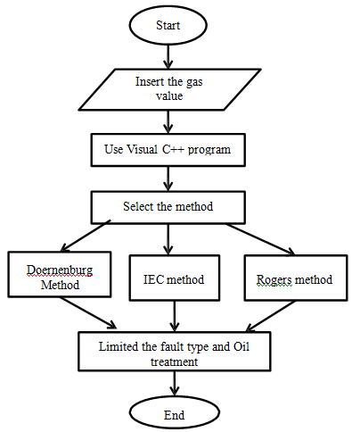
Flow Chart

Slide 12
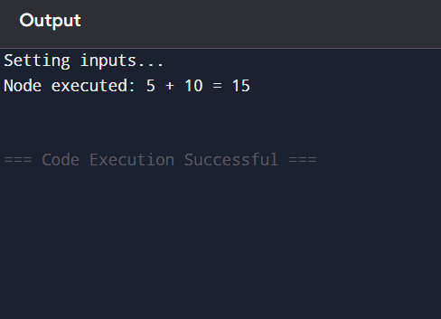
Output

Slide 13
Discussion on Implementation Outcomes
Improved Parallel Execution • Efficiently exploits parallelism by dynamically scheduling independent computations.
Increased Efficiency in Data-Intensive Applications • Reduces bottlenecks caused by sequential execution in traditional compilers.
Enhanced Code Scalability • Programs can scale efficiently with increasing hardware resources.
Compilation Overhead • Additional preprocessing and dependency analysis increase compile time..
Compatibility with Existing Codebases • Interoperability with imperative and object-oriented languages requires additional compiler support.

Slide 14
Future Enhancements for Compiler Dataflow
Vision • To transform the compilation process for dataflow-oriented languages by enhancing parallelism, efficiency, and adaptability for modern computing needs.
Mission • To develop next-generation compilers that intelligently analyze, optimize, and execute data-driven workflows with minimal overhead.
Values • Implement machine learning models to predict optimal execution strategies based on code patterns.

Slide 15
Technological Advancements
Parallel Processing Enhancements • Advanced thread scheduling and workload balancing optimize parallel performance.
High-Performance Memory Management • Smart caching techniques optimize data reuse and minimize redundant computations.
Hardware Acceleration • Specialized accelerators like FPGAs and TPUs enhance the execution of dataflow programs.
Hybrid Execution Models • Combining dataflow and imperative execution models allows for better adaptability across different programming paradigms..
AI-Driven Optimization Techniques • Machine learning models analyze program execution patterns to optimize data dependencies..

Slide 16
Interactive Query Handling in Compilers
Receive Query • The compiler receives user queries for language processing and analysis.
Process Query • Natural language processing techniques are utilized to analyze and interpret the query.
Generate Feedback • Feedback is generated based on the analysis, providing insights or corrections.
Respond User • The response is delivered to the user, closing the interaction loop.

Slide 17
User Feedback and Adjustments
Surveys • Utilize surveys to collect user opinions and suggestions. Feedback Forms • Implement feedback forms for users to report their suggestions easily.
Beta Testing • Engage users in beta testing to gather preliminary feedback on features.
Focus Groups • Organize focus groups to discuss and evaluate key functionalities.
Improvement Tracking • Track changes made based on feedback to evaluate their effectiveness.

Slide 18
Conclusion
Enhancing Parallelism • Dataflow-oriented compilers enable efficient parallel execution by leveraging dependencies instead of sequential control flow.
Optimized Execution • Advanced scheduling and dynamic execution models ensure efficient resource utilization.
Scalability and Efficiency • Ideal for large-scale, data-intensive applications such as AI, machine learning, and real-time analytics..
Future Directions • Continuous improvements are necessary to address ongoing challenges in language learning models.

Slide 19
References
“Streamc language specification,” http://graphics.stanford.edu /streamlang/streamc-3-6-00.pdf.
[2] Alberto Sangiovanni-Vincentelli, “Quo Vadis, SLD? Reasoning About the Trends and Challenges of System Level Design,” Proceedings of the IEEE, vol. 95, pp. 467–506, 2007.
[3] Petri Kukkala, Mikko Setala, Tero Arpinen, Erno Salminen, Marko Hannikainen, and Timo D. Hamakainen, “Implementing a wlan video terminal using uml and fully automated design flow,” EURASIP J. Embedded Syst., vol. 2007, pp. 20–20, 2007. [4] D. Thomas, “Mda: revenge of the modelers or uml utopia?,” Software, IEEE, vol. 21, pp. 15–17, 2004.
[5] G. De Micheli, “Hardware synthesis from c/c++ models,” in Design, Automation and Test in Europe Conference and Exhibition 1999. Proceedings, 1999, pp. 382–383.

Slide 20
Thank You!

